Slide 2
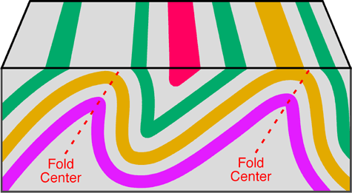
Lecture # 6
Geological Structures
( Folds, Faults and Joints)
Instructor:
Prof. Dr. Attaullah Shah
Department of Civil Engineering
City University of Science and IT Peshawar

Slide 3
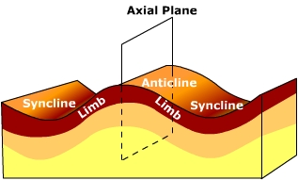
Geological Structures: Folds
Strata in many parts of the Earth's crust have been bent or buckled into folds; dipping beds, are often parts of such structures.
The wavy undulations in the rock beds are called folds. This is when the rocks deform by plastic deformation. The process of folding occurs when rock is compressed, as it is along colliding plate boundaries. They consist of arches and troughs in alternate manner. The size of folds vary greatly. Width of some folds are measured in kilometers while those of others in meters or centimeters.
3

Slide 4
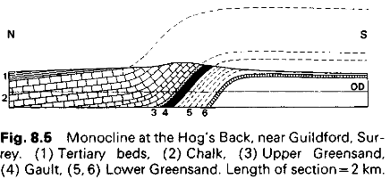
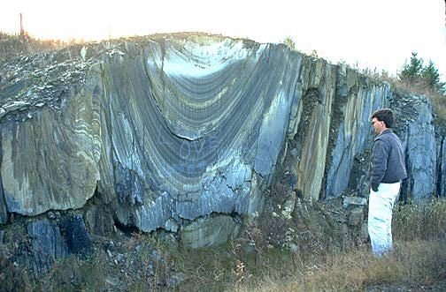
Geological Structures: Folds
Terminology: An arched fold in which the two limbs dip away from one another is called an antiform, or an anticline when the rocks that form its central part or core are older the outer strata.
A fold in which the limbs dip towards one another is a synform, or a syncline when the strata forming the core of the fold are younger than those below them
Limbs: The sloping side of a fold from crest to trough is called the limb.
Axial Plane: It is an imaginary plane or surface which divides the fold into equal halves.
Axis: The line of intersection of the axial plane with the surface of any of the constituent rock beds is known as the axis of the fold.
The name monocline is given to a flexure that has two parallel gently dipping (or horizontal) limbs with a steeper middle part between them
4

Slide 5
Types of folds
Symmetrical Folds: A ‘symmetrical folds’ is one where the axial plane is vertical and the two limbs have the same amount of dip.
Asymmetrical folds: An asymmetrical folds is one where the axial plane is inclined and the limbs dip at different angles, and in opposite directions.
Overturned folds: Overturned folds is one in which the axial plane is inclined and one limb is turned past the vertical. If the compression is more pronounced from one direction, an overturned fold may occur.
5

Slide 6
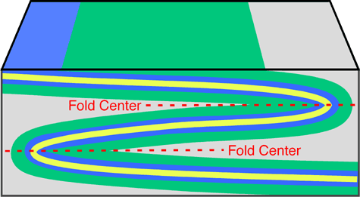
Types of folds
Recumbent fold: A recumbent fold develops if the center of the fold moves from being once vertical to a horizontal position. Recumbent folds are commonly found in the core of mountain ranges and indicate that compression and/or shear forces were stronger in one direction. Extreme stress and pressure sometimes causes the rocks to shear along a plane of weakness creating a fault.
Isoclinal fold: This type of fold shows parallel limbs which dip at the same angle and in the same directions.
6

Slide 7
Types of folds
Fan Folds: In ‘fan folds’ the beds in the limbs of the anticline are seen to dip in from both sides towards the axial plane. The beds within the anticline are much compressed below while they open out above. The crests and troughs of fan folds are generally sufficiently rounded.
7

Slide 8
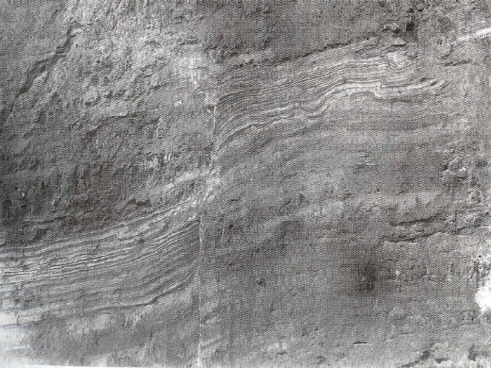
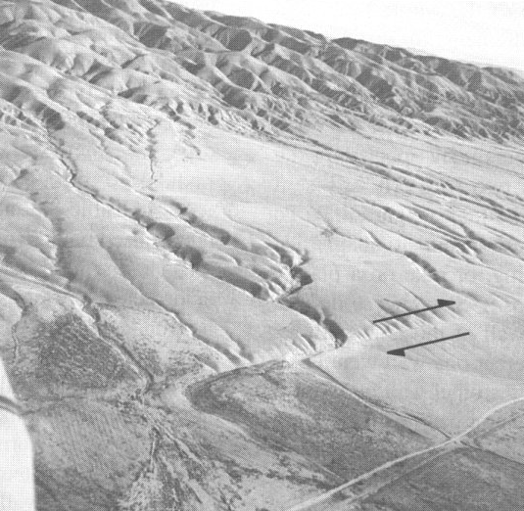
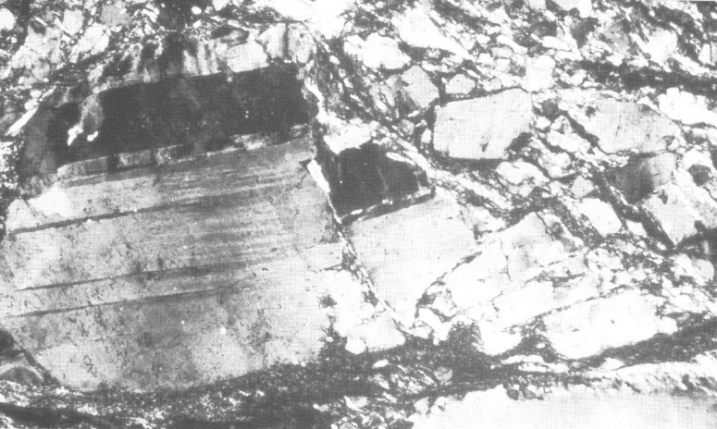
Types of folds
Dip: It is the angle of inclination of a rock bed with the horizontal plane.
Strike: It is the direction of a line formed by the intersection of the plane of a bed with a horizontal plane. The strike is always at right angles to the true dip.
Fractured feldspar grain in photomicrograph
Mesoscopic faults in outcrop
Fault trace in aerial photo
8

Slide 9
FAULTS
A fault is any surface or zone in the Earth across which measurable slip (shear displacement) develops.
Faults are fractures on which slip develops primarily by brittle deformation processes.
Fault zone is a brittle structure in which loss of cohesion and slip occurs on several faults within a band of definable width.
Shear zone: occurs at depth without definable displacement on the surface

Slide 10
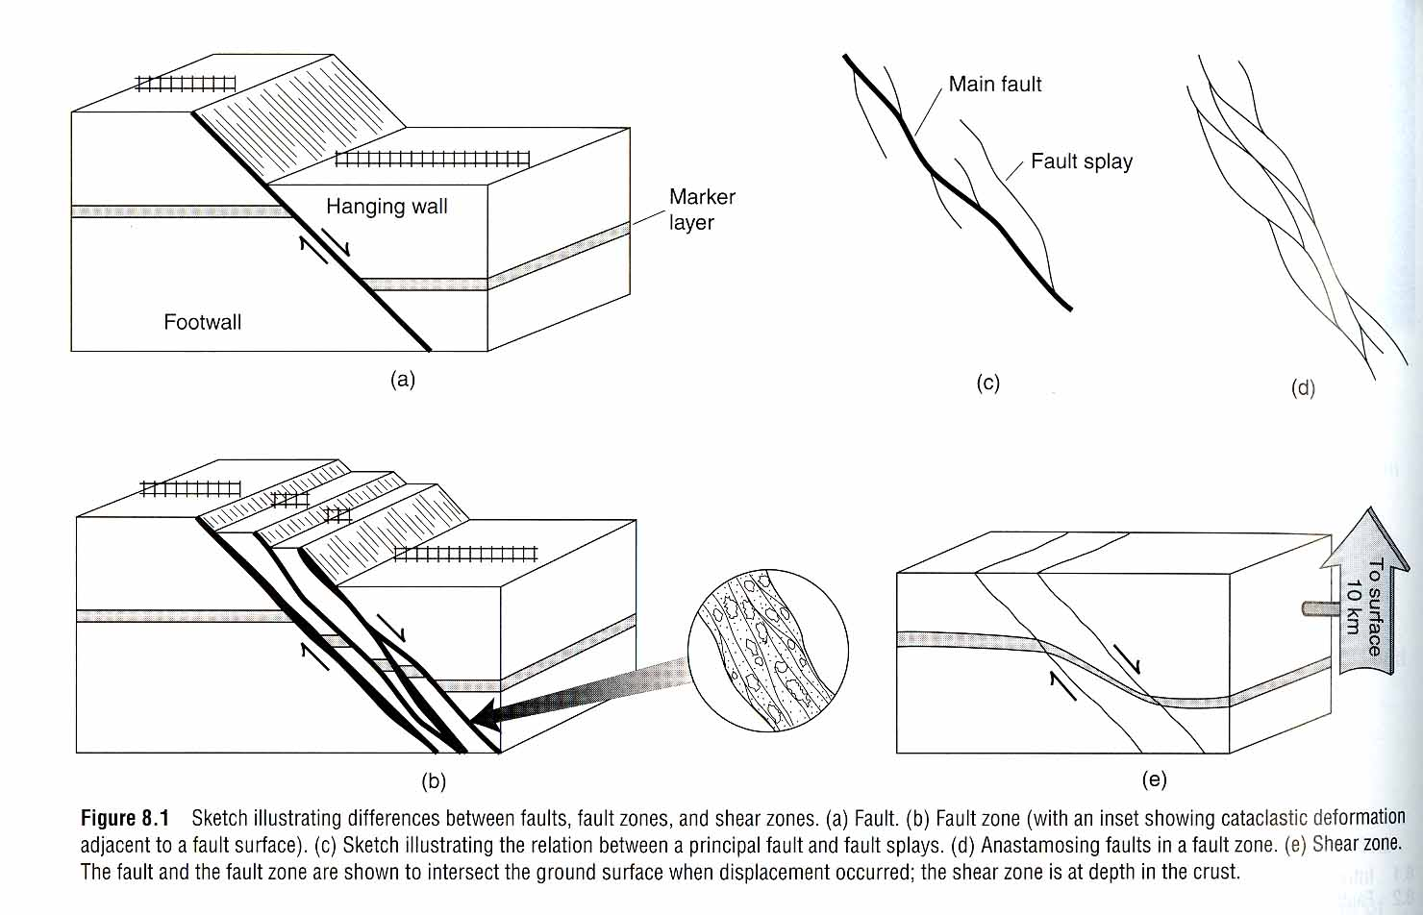

Slide 11
Relative scales of faults observations
Micro: optical scale (microscope or even electron microscope).
- Meso: single outcrop (personal scale).
- Macro: regional scale (mountain range).
- Mega: continental scale (plate dimensions).
Fractured feldspar grain in photomicrograph
Mesoscopic faults in outcrop
Fault trace in aerial photo
11

Slide 12
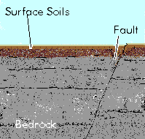
Geological Features: Faults
Faults
A fault is a fracture within some particular rocky mass within the earth's crust.
The depth and length of faults vary greatly. Some faults can be many miles long.
Earthquakes are caused by Active faults, that is, faults along which the two sides of the fracture move with respect to each other.
An earthquake is caused by the sudden movement of the two sides of a fault with respect to another.
A Fault

Slide 13
Terminology related to faults
Terminology Related to faults
Dip:
The angle between a geologic surface -- for example, a fault plane -- and the horizontal. The direction of dip can be thought of as the direction a ball, if placed upon the tilted surface, would roll. Thus, a ball placed on a north-dipping fault plane would roll northward
Strike:
The direction, or trend, of the line marking the intersection of a fault plane (or another planar geologic feature) with the horizontal. Strike is always at a right angle to dip.

Slide 14
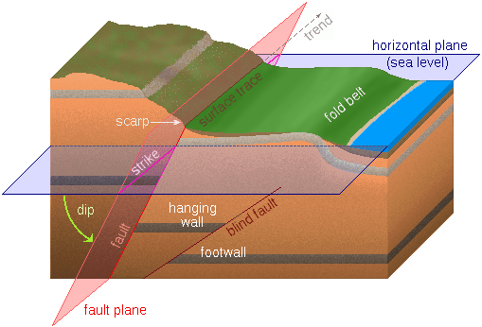
Fault
Geological Features: Faults
90˚ dip = vertical fault plane
0˚ strike = North parallel fault plane

Slide 15
Terminology related to faults
Terminology Related to faults
Hanging wall
Of the two sides of a fault, the side above the fault plane. It is called the hanging wall because where inactive faults have been "filled in" with mineral deposits and then mined, this is the side on which miners can hang their lanterns
Footwall
Of the two sides of a non-vertical fault, the side below the fault plane. It is called the footwall because where inactive faults have been "filled in" with mineral deposits and then mined, this is the side on which miners walk

Slide 16
Fault Types
Faults Type
Faults can be divided into three categories
Dip-Slip Faults: Fault surfaces are inclined (i.e. not vertical, not horizontal). Motion is up or down along fault
Normal or Listric -Hanging block moves down
Reverse or Thrust -Hanging block moves up
2) Strike-Slip Faults: Fault surfaces are vertical. Motion is horizontal
Right-Lateral
Left-Lateral
3) Oblique-Slip Faults: Fault surfaces are inclined. Motion up and down and horizontal. Combination of Dip-Slip and Strike- Slip Motion

Slide 17
Fault types
The most common types of faults are:
1. Dip-slip faults
Normal (Listric)
Reverse or Thrust (if dip angle <45º)
2. Strike-slip faults
3. Oblique-slip faults
Other faults: Scissors (Rotational).

Slide 18
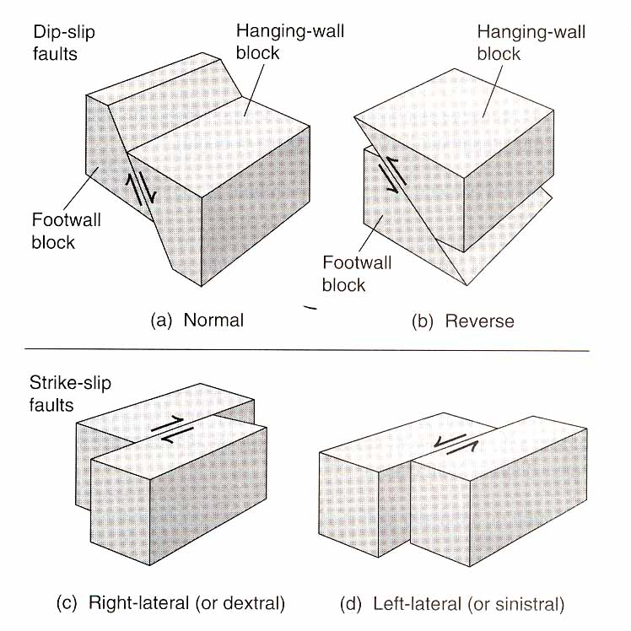

Slide 19
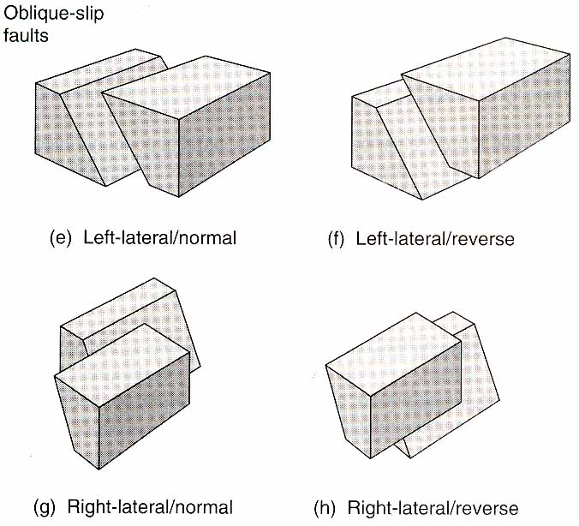

Slide 20
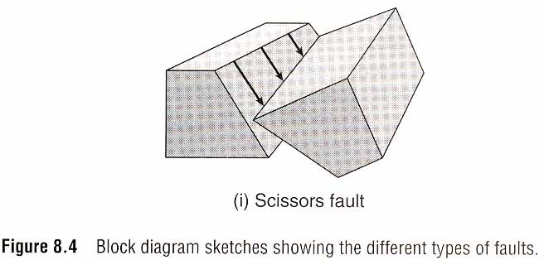

Slide 21
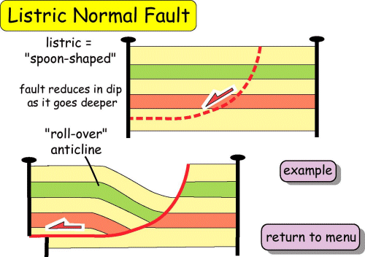

Slide 22
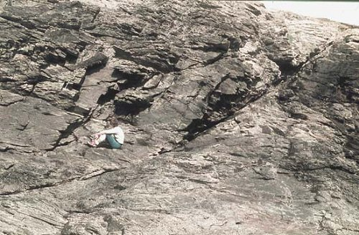
listric fault

Slide 23
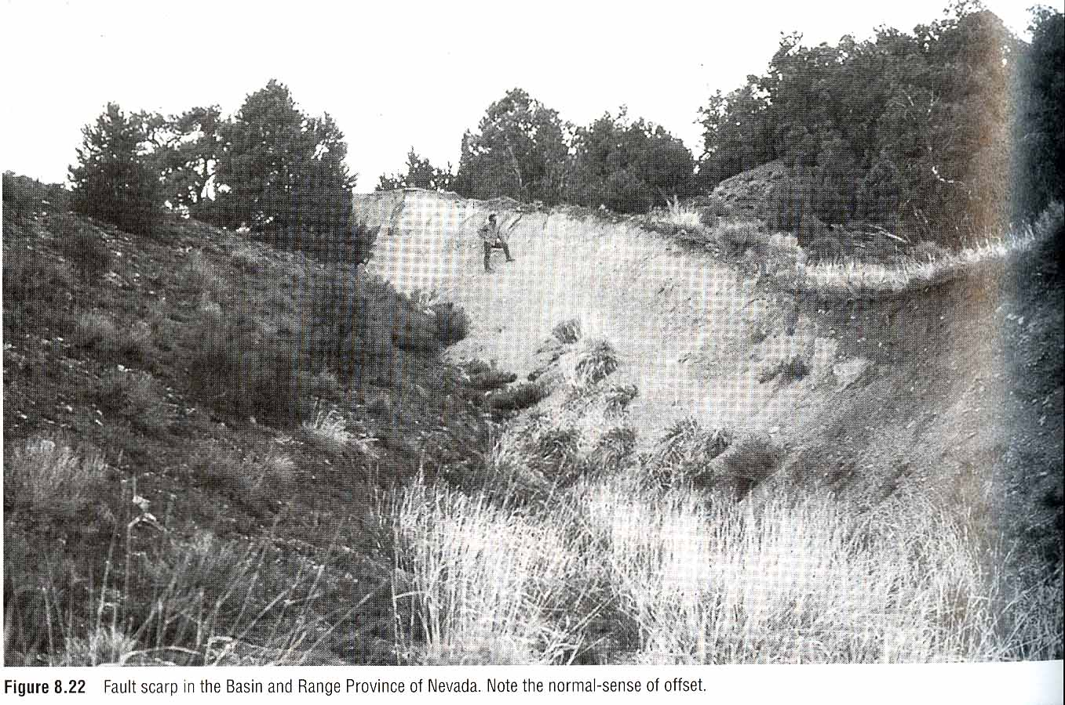

Slide 24
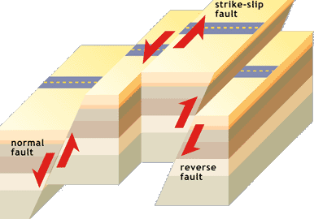
Faults Type

Slide 25
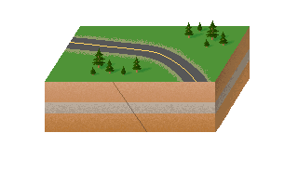
Normal Dip-slip fault
Normal dip-slip fault
The normal fault is not necessarily normal in the sense that it is common....because.... it is not the most common of faults. However what is normal about them is that their movement tends to follow the gravitational pull on the fault blocks involved.
Hanging wall moves down

Slide 26
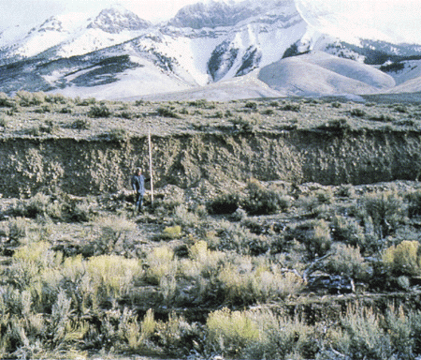
Normal Dip-slip fault
Normal dip-slip fault
A Normal dip slip fault

Slide 27
Normal dip-slip fault
Normal Dip-slip fault
The fault plane on the normal fault is generally very steep.
In a normal fault the two involved blocks are (by gravity) pulling away from one another causing one of the fault blocks to slip upward and the other downward with respect to the fault plane (it is hard to determine whether both or just one block has moved.).
The exposed upward block forms a cliff-like feature known as a fault scarp. A scarp may range from a few to hundreds of meters in height and their length may continue for 300 or more kilometers (around 200 miles).

Slide 28
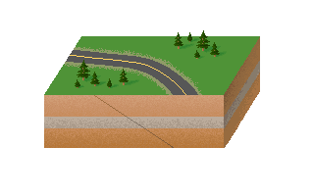
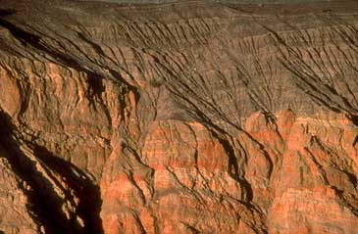
Reverse Dip-Slip Fault
Reverse dip-slip fault
The reverse fault is a normal fault except the general movement of the fault blocks is toward each other, not away from each other as in the normal fault.
This forms a Thrust fault type expression on the surface with material overlaying other material
Hanging wall moves up

Slide 29
DESCRIPTION OF FAULT DIP
0 →horizontal fault
0 -10 →sub horizontal fault=Detachment:A regional, low-angle, listric normal fault formed during crustal extension
10-30→shallowly dipping faults
30-60→modertly dipping fault
60-80→steeply dipping faults
80-90→sub vertical fault
90 →vertical fault

Slide 30
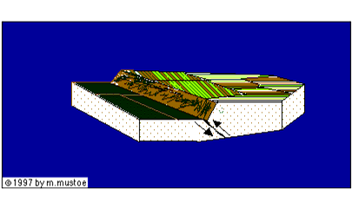
Normal dip-slip fault
Reverse Dip-Slip Fault
Scarp

Slide 31
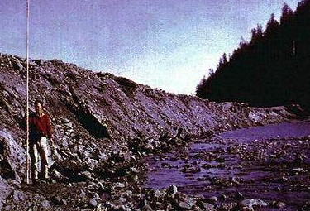
Reverse Dip-Slip Fault
Normal dip-slip fault
Scarp
A reverse dip-slip fault

Slide 32
Normal dip-slip fault
Reverse Dip-Slip Fault
They are normally associated with areas of folded surfaces and or mountainous regions.
The dip angles of thrust faults are normally not as steep as a normal fault.
In the 1994 Northridge, California event, a deep thrust fault located about 18 km under the city of Los Angeles produced an earthquake that registered a magnitude of 6.7.

Slide 33
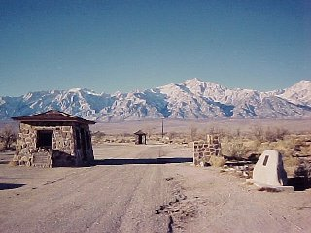
Normal dip-slip fault
The Sierra Nevada in California is bounded on the east by a great fault scarp that produced a magnitude 8 earthquake in 1872. The scarp rises over 10,000 feet. Mount Whitney, highest point in the conterminous U.S., is just out of the picture to the left.

Slide 34
Normal dip-slip fault
Reverse Dip-Slip Fault (Real Example)
The night of 17 August , 1959 marks the anniversary of a little talked about yet profoundly significant earthquake known as the Hebgen Lake, or Montana-Yellowstone Earthquake.
On that night nearly 18,000 campers and park personnel, felt a shock that had originated ten miles below the surface in the vicinity of the Madison River Canyon.
As a result of that 7.1 magnitude earthquake, 43 million cubic yards of rock slid as a block into the Madison Canyon daming up the Madison River, below Hebgen Dam.

Slide 35
Normal dip-slip fault
Reverse Dip-Slip Fault (Real Example)
The lake basin behind Hebgen dam tilted with the south side rising and the north side dropping.
This caused a seische...a lake tsunami...that crested the dam four times and kept the lake in motion for nearly 11 hours.
The shock wave was felt in an area of 500,000 sqaure miles. It caused wells to fluxuate in Texas and and as far away as Hawaii and Puerto Rico.
Nine people lost their lives and 19 were listed as missing in this event.

Slide 36
Blind thrust fault `
Blind thrust fault
A shallow-dipping reverse fault which terminates before it reaches the surface. When it breaks, therefore, it may produce uplift, but never any clear surface rupture.
Many still-unknown blind thrust faults may exist in southern California. Two examples of known blind thrust faults: the Elysian Park Thrust, which runs underneath downtown Los Angeles and the Northridge Thrust Fault, which ruptured in the 1994 Northridge quake.

Slide 37
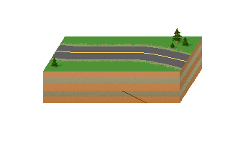
Blind thrust fault
Blind thrust fault

Slide 38
Strike-Slip Fault
Strike slip fault
Movement on a strike strip fault is generally horizontal.
On the surface, scarps form as hills crossing the fault zone are torn apart by movement over time. Actually anything crossing this fault zone is either slowly torn apart, or offset.
Probably the most well known and well studied fault is the transcurrent (strike-slip) fault known as the San Andreas fault of California.
This fault marks the margin line between the Pacific and North American Plates.
Rivers crossing the fault line are called offset streams and are classic signatures of fault activity along the San Andreas. These faults can be very long, the San Andreas is nearly 600 miles long.

Slide 39
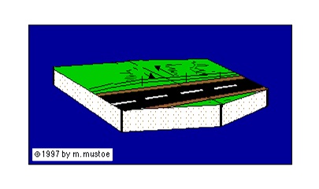
Strike slip fault
Strike-Slip Fault

Slide 40
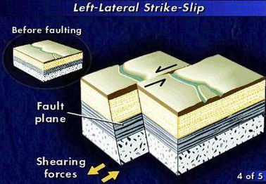
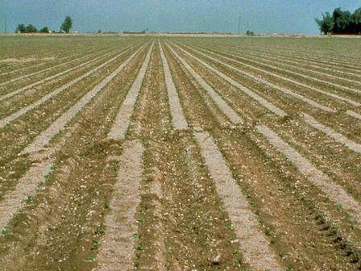
Strike-slip fault
Strike slip fault
Displacement in horizontal direction
A strike-slip fault

Slide 41
Strike-Slip Fault – Left Lateral

Slide 42
Strike-Slip Fault – Right Lateral

Slide 43
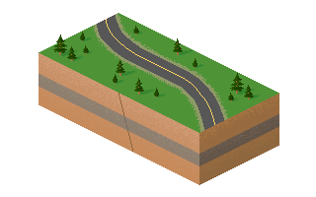
Oblique-slip fault
Displacement in both vertical and horizontal directions

Slide 44
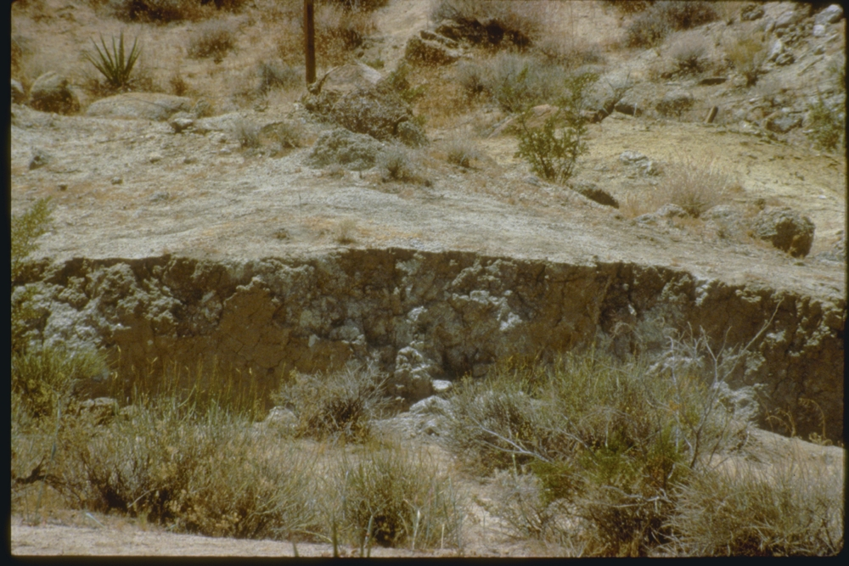
Oblique-slip fault
An oblique-slip fault

Slide 45
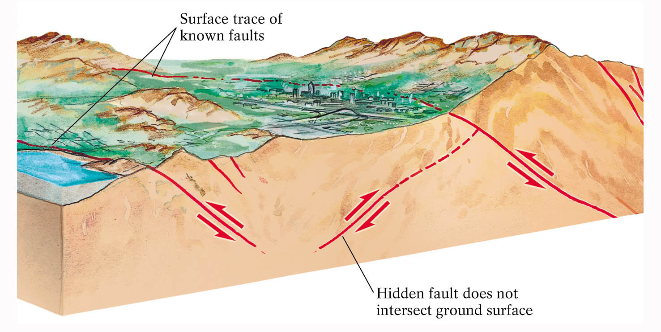
Blind/Hidden faults

Slide 46
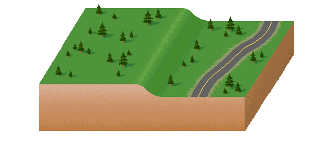
SCARP FORMATION
Scarps can be created by non-vertical motion. (More generally, apparent offset does not always equate with actual displacement.)

Slide 47
Emergent Fault
Faults can also terminate at the ground surface, or appear to
The San Andreas fault does terminate at the ground surface, and is called an emergent fault.
Notes:
Image: San Andreas Carrizo dis01bigb.jpg

Slide 48
Sequence of Events
1) Tectonic loading of faults
2) Earthquakes
3) Seismic waves
4) Shaking (ground motion)
5) Structural failure

Slide 49
Geological Structures: Joints
Terminology Related to faults
Joints: Joints are cracks or fractures present in the rocks along which there has been no displacement. Joints occur in all types of rocks. They may be vertical, inclined or even horizontal. There dip and strike are measured in the same way as that of sedimentary strata.
Formation of Joints: Joints are formed as a result of contraction due to cooling or consolidation of rocks. They are also formed when rocks are subjected to compression or tension during earth movements.

Slide 50
Classification of joints
Terminology Related to faults
Tension Joints: Tension joints are those which are formed as a result of tensional forces. These joints are relatively open and have rough and irregular surfaces.
Shear Joints: Shear joints are those which are formed due to shearing stresses involved in the folding and faulting of rocks. These joints are rather clean cut and tightly closed.

Slide 51
Major Faults of Pakistan
Pakistan is characterized by extensive zones of moderate to high seismicity, induced by the regional collisional tectonics associated with Indian and Eurasian plates and resulting in manifestation of great Himalayan and associated mountain ranges.
The geographic domain of Pakistan comprises a network of active seismotectonic defined five broad seismotectonic zones
Himalayan seismotectonic zone in the north,
Suleman-Kirthar thurst-fold belt,
Chaman-Ornach Nal Trasform Fault Zone,
Makran Subduction Zone in the west, and
Run of Kutch Seismotectonic Zone in the southeast.
The Pamir-Hinukush Seismic Zone straddles across Afghanistan and Tajikistan outside Pakistan but in close vicinity of the NW Pakistan comprising District Chitral.
51

Slide 52
Major Faults of Pakistan
Major active faults of Pakistan and surrounding areas that strongly influence the seismic hazard are listed below:
Main Karakoram Thrust
Raikot Fault
Panjal-Khairabad Thrust
Riasi Thrust
Salt Range Thrust
Bannu Fault
Chaman Transform Fault
Quetta-Chiltan Fault
Pab Fault
Allah Bund Fault
Hoshab Fault
Makran Coastal Fault
Main Mantle Thrust
Main Boundary Thrust
Himalayan Frontal Thrust
Jhelum Fault
Kalabagh Fault
Kurram Fault
Ornach-Nal Transform Fault
Kirthar Fault
Kutch Mainland Fault
Nagar Parkar Fault
Nai Rud Fault
52

Slide 53
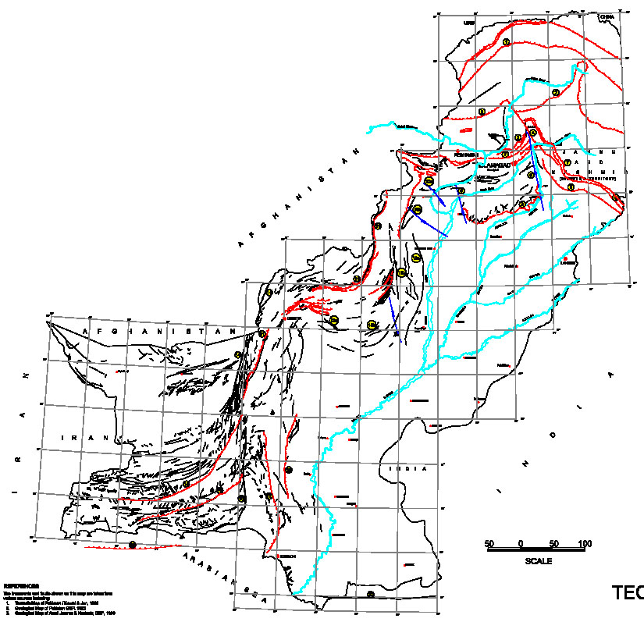
SEMINAR
ACI CODE
Tirich Mir-Misgar F.
Fault Map of
Pakistan
MKT
Indus-Kohistan F
Muzafarabad T.
MMT
Kurram T.
Panjal T.
SRT
MBT
Waziristan T.
Jhelum F.
Kalabagh F.
Raisi T.
Chaman F.
Sulaiman Frontal T.
Ghazaband T.
Hoshab F.
Kirthar F.
Hoshab F.
Pab F.
Rann of Kuchh F.
MakranSubduction Zone
OrnachNal F.
After NESPAK 2006
53

