Slide 1
Publish and Flourish Publishing scholarly articles in refereed journals
Prof. Dr. Attaullah Shah
City University of Science and IT Management
Peshawar Pakistan
vc@cusit.edu.pk
www.cusit.edu.pk

Slide 2
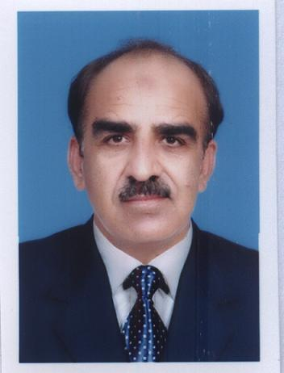
Bio details of the Speaker
Dr. Attaullah Shah
Vice Chancellor City University of Science and IT Peshawar
Previously Director ( Planning and Projects AIOU)
pdaiou@yahoo.com. pd@aiou.edu.pk, www.drshahpak.weebly.com
+92-333-5729809, +92-51-9057212
Qualification
PhD Civil Engineering ,M.Phil Eco ,MSc Structure Engg
MBA, MA Eco, MSc Envir Design,BSc Civil Engg (Gold Medal), Post Grad Dip Comp (Gold Medal)
Professional and Field experience:
25+ Years
Research Publications in refereed journals and conferences:
25 Journals publications+55 Conference publications
Areas of interests
Structural Engineering
Sustainable built Environment
Construction project Management

Slide 3
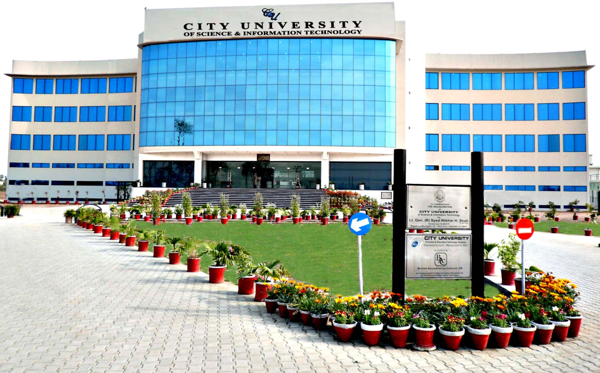
CITY UNIVERSITY OF SCIENCE AND INFORMATION TECHNOLOGY, PESHAWAR

Slide 4
About University
Name of degree awarding university | City University of Science & Information Technology(CUSIT), Peshawar
Nature of linkage with the University (Affiliated or Constituent) | Chartered by Govt. of Khyber Pakhtunkhwa on 30 August 2001 Off Spring of Peshawar Model Educational Institutions providing education to 25000+ students from Nursery to Higher Secondary level Four Faculties ( Engineering, IT/CS, Magement Sciences, Social Sc and Humanities
 | Recognized by HEC and placed in Category “W” One of the 5 top ranked Universities in Comp and IT
Type of Management Engineering Programs | Accredited Pakistan Engineering Council (PEC) and National Computing Education Accreditation Council (NCEAC) Approved Professional Engineering Body Privately sponsored and chartered by the Govt. of KPK Civil Engineering, Electrical, Telecom, Electronics
4
4

Slide 5
Some quotes about research
If we knew what it was we were doing, it would not be called research, would it? Albert Einstein.
Research is creating new knowledge- Neil Armstrong
Research is formalized curiosity. It is poking and prying with a purpose. Zora Neale Hurston
If you steal from one author it's plagiarism; if you steal from many it's research. Wilson Mizner
Research is what I'm doing when I don't know what I'm doing. Wernher von Braun.
Academic success depends on research and publications. Philip Zimbardo

Slide 6
Some quotes about Plagiarism
“Anticipatory plagiarism occurs when someone steals your original idea and publishes it a hundred years before you were born.” ― Robert K. Merton
“Originality is undetected plagiarism”. William Ralph
Certainly the plagiarism, and dealing with the fallout of it, was the most difficult thing I've ever faced since I started writing. Nora Roberts
The only 'ism' Hollywood believes in is plagiarism. Dorothy Parker
The secret to creativity is knowing how to hide your sources. Albert Einstein

Slide 7
Contents of Presentation
Research and Development Overview
R&D Spending Trends
Obstacles to R&D
Benefits of R&D
Research Organizations
Way Forward

Slide 8
SCIENCE AND ENGINEERING R&D SPENDING
The U.S. remains the leader in total R&D spending, accounting for 34% of the world total.
In 2011, $33 billion in funding was spent on science, while $6 billion was spent on engineering
Increases substantial in the last decade
President Obama requested $146.696 billion for R&D in FY 2011. Much of this spending is devoted to research on diseases.

Slide 9
Trends in R&D by function

Slide 10
Energy Spending
The United States and Japan are the dominant public sector supporters of energy R&D.
The combined funding of the U.S. and Japanese governments exceeds by approximately 500% the combined support of the other nine industrialized countries
Measured as a percentage of GDP, however, energy R&D investment in the U.S. ranks fifth among the eleven countries, while Japan ranks first.

Slide 11
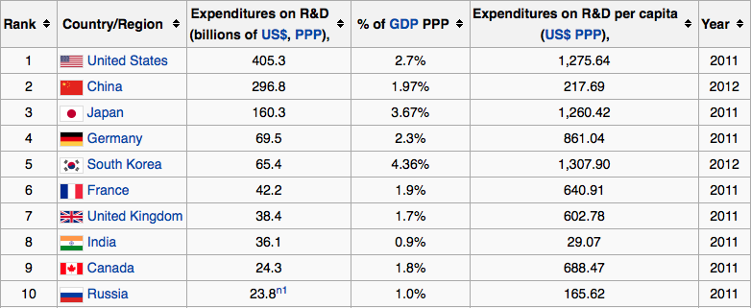
Top 10 Countries R&D Spending

Slide 12
Benefits of R&D in Science and Engineering
Instrumental in creating new products and adding features
Attracts new customers and wins customer interest
Success of R&D depends on the practices, talents, and innovations of the people working. Companies can spend less money on R&D and still yield good results.
R&D encourages trend matching with the market.
Enhanced reputation

Slide 13
Why we do Research?
‘Sustain academic and professional reputation in knowledge-based economy’
‘Align academic activities with economic development of region’
‘Retain and improve position’
‘Attract and retain high quality faculty and students’
‘Maintain cutting-edge curriculum’ and ‘create stimulating learning environment’

Slide 14
Why Publish?
To enrich the body of knowledge
To disseminate research results
To fulfill academic job requirements
To derive gratification from self fulfillment
To avoid getting perished!

Slide 15
Types of Scholarly Papers
Review – in depth discussion on a topic of interest
Research results – usually from thesis or dissertation
Case Studies – based on industry practices
Technical Notes – less rigorous
Discussions – on already published papers
Forum Articles – opinion based

Slide 16
Review Papers
Examples
Papajohn, D. et al. “Public-Private Partnerships in US Transportation: Research
Overview and a Path Forward,” Journal of Management in Engineering, ASCE, July 2011.
Azhar, S. et al. “Action Research as a Proactive Research Method for Construction Engineering and Management,” Journal of Constr. & Engr. Management, ASCE,
January 2010.
Review Papers
Main Features:
Topic is important, debatable, controversial, lacks consensus
In depth literature review with analysis

Slide 17
Research Results [1]
Usually from thesis or dissertation
Research Types:
Experimental research
Qualitative research
Quantitative research

Slide 18
Experimental Research
Laboratory experiment
Field experiment
Computer simulation
Hypothesis testing

Slide 19
Qualitative Research
Qualitative research methods were developed in the
social sciences to enable researchers to study social and cultural phenomena.
Examples of qualitative methods are action research, case study research and ethnography.
Qualitative data sources include: observation and participant observation (fieldwork), interviews and questionnaires, documents and texts, and the researcher's impressions and reactions (Myers 2009 - Myers, M.D. Qualitative Research in Information Systems. Sage Publications, London, 2009.)
http://www.qual.auckland.ac.nz/

Slide 20
Quantitative Research
Quantitative research methods were originally developed in the natural sciences to study natural phenomena.
Examples of quantitative methods are now well accepted in the social sciences include survey methods, laboratory experiments, formal methods (e.g. econometrics) and numerical methods such as mathematical modeling.
See the ISWorld Section on Quantitative, Positivist Research edited by Straub, Gefen and Boudreau (2004).
Straub, D., Gefen, D., and Boudreau, M.-C. "The ISWorld Quantitative, Positivist Research Methods
Website", 2004, http://dstraub.cis.gsu.edu:88/quant/

Slide 21
Research Results [2]
Examples
– Ahmad, I. and S. Azhar, “Temperature variation in high slump drilled shaft concrete and its effect on slump loss,” Cement and Concrete Research, 34(2004), Pergamon. (Engineering Research)
Ahmad, I., et al. “Development of a decision support system using data warehousing to assist builders/developers in site selection,” Automation in Construction, 3(4), Elsevier, July 2004. (Qualitative Research)
Ahmad, I. and I. Minkarah, “Questionnaire Survey on Bidding in Construction,” Journal of Management in Engineering, 4(3), ASCE, July 1988. (Quantitative Research)

Slide 22
Research Results [3]
Main Features:
Research question or hypothesis
Literature Survey
Methodology
Results
Conclusions (and recommendations)
Directions for future research

Slide 23
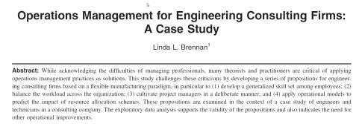
Case studies
Generalization from one or more cases
Lessons learned
Difficult to draw conclusions
Example -
Case Studies

Slide 24
Types of papers – the rest
Technical Notes – Not as rigorous as research or review papers
Discussions – on already published papers
Forum Articles – opinion-based, usually
Not refereed

Slide 25
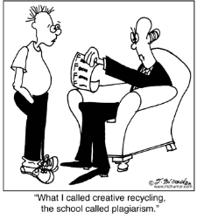
Frontend: Writing a good quality scholarly paper

Slide 26
Purpose of the paper
The paper reporting research must have a clear purpose - if you don’t know why you did the research or why you’re writing the paper what chance does the reader have to understand what you are trying to achieve
Key: Simplicity

Slide 27
Planning - How to develop an idea into a paper?
• Theme –
– Idea about the subject matter
– What is the topic?
– Usually a question
– Usually suggests the title of the paper
• Storyline –
– What is the story?
– How will it start, how will it end?
– How does the story flow?
• Outline –
– Headings, subheadings

Slide 28
Title
15-20 words, make it as simple as possible
Example

Slide 29
Abstract
Written at the end but placed at the beginning of the paper
200-500 words
Purpose of the research
Design/methodology/approach
Findings
Research limitations/implications
Practical implications
Social implications
Originality/value

Slide 30
Contents–Organization of a paper [1]
Introduction –
What is the paper about
Motivation to write the paper
Objective of the paper/research
Scope of paper/research
Organization of the paper
Problem Statement –
Research question
– Why existing knowledge cannot answer the
question?? – The Research Gap

Slide 31
Contents–Organization of a Paper [2]
Literature Survey
On the topic
On the method
Research Methodology
Findings/Results/Validation
Conclusions
Main contributions of the paper
Future Research

Slide 32
Main Findings and Conclusions
The purpose of research is to reach at conclusions, the ONLY purpose of publishing is to present these conclusions
No conclusions
No purpose – no reason to publish
Papers need strong
conclusions

Slide 33
Conclusions
Weak Conclusions:
Some authors write papers with long descriptions of literature, detailed descriptions of research method, present many tables of results (all demonstrating how hard they worked)
AND
End by amazing weak conclusions of no consequence.

Slide 34
Contents–Organization of a Paper [3]
References
consistent format
APA style - http://www.apastyle.org/
Journal specific
Acknowledgements
Acknowledge project sponsors
Appendix
– Questionnaire survey instrument, etc.

Slide 35
Contents–Organization of a Paper [4]
Figures/Photographs
Must be discussed in the paper
Must have a number and a caption
Must be of good quality
Tables
Must be discussed in the paper
Must have a number and a title
Should be easily comprehensible
Both should be placed in appropriate sections of the paper

Slide 36
Writing Style [1]
Your reader should be able to understand:
Why you undertook the research
What was the starting point of the research
What was your research approach
What were your conclusions
What are the practical implications
You are not writing
To reproduce your research report or PhD
Or to demonstrate how much effort/pain/anguish you suffer• Or to share with the reader all the pain you suffered
Your job is to make it easy for the reader to understand what you achieved.

Slide 37
Writing Style [2]
Clear and concise
Don’t write in a long winded way with
Too many words
Overly complicated sentences or paragraphs
Good writing is short writing-the longer it is the less you are explaining

Slide 38
Writing Style [3]
Structure
– Have a clear structure with headings
– Let the reader understand what you are writing by simply reading the headings—
they won’t have the detail but they will have an understanding

Slide 39
Writing Style [4]
Set out your headings before you write your paper
Use the planning of your headings to plan your paper-this will make you think about the structure and balance of your paper
Write your conclusions first-so that you know what you are aiming for!

Slide 40
Writing Style [5]
Remember you are writing so that the reader understands with the minimum effort.
Don’t bore the reader with:
– Long tedious descriptions of the literature review—only need the key summary points and the references—to reproduce the literature is only to print what has already been published
– You may have suffered greatly in conducting the review but that is no reason why you should pass the suffering onto the reader

Slide 41
Writing Style [6]
Don’t review the 16 research methods that you studied before choosing your preferred method
Tell the reader what method you chose and why

Slide 42
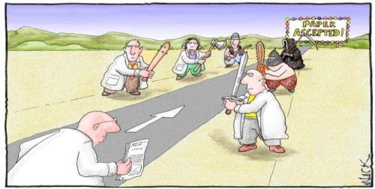
Backend: The Paper Review process
Which Journal to Choose?
List of Journals – Find out the most reputable journals in your field, longevity, impact factor
Blind review – double v. single
Turn around time – 3 to 6 months

Slide 43
The Paper Review Process –
Step 1
Quick review by the editorial staff – for styleand formatting
Use of iThenticate software for checking the originality of submissions received/ Turnitin
Preliminary review by associate editors to determine suitability for the peer-review
Step 2
Each paper is then sent to at least three referees for blind (single/double) peer review
Based on their recommendations, the editor then decides whether the paper should be
accepted as is, revised or rejected.

Slide 44
The Paper Review Process
Referees
Typically three referees are invited
Editorial decisions are taken on the reports of two
Different referees have different focus:
Some concentrate on the research methodology
Some focus on the definition of the problem
Some focus on the strength of the conclusions
Some concentrate on the standard of writing

Slide 45
The Paper Review Process –
Step 3
The revised paper can be reviewed by the
Editor/associate editors OR can be sent back to the same or different reviewers.
The re-review process can be repeated up to 2 times.
If accepted, the final paper is copy edited and queued for publication.

Slide 46
Do’s and Don’ts! The Editor’s Perspective
Do’s
– cite and quote properly
– edit edit edit
– rewrite rewrite rewrite
Don’ts
– grammatical mistake
– quote without credit
– plagiarize (even by mistake)

Slide 47
Originality Guidelines
Avoid:
Verbatim copying
Re-using parts of a work without attribution
Self-plagiarism
Republication of original work

Slide 48
Guidelines in Making Decisions about Ethical Misconduct
Ethical issues include:
Plagiarism
Redundant publication (dual publication or self plagiarism)
Authorship issues
Fabricated data
Unethical research and testing

Slide 49
Publication Guidelines [1]
Authors agree:
The article has not been published before in its current or a substantially similar form.
The article is not under consideration with another journal.
The article does not contain any unlawful statements and does not infringe any existing copyright.
Authors warrant that:
They have obtained the necessary permission from the copyright holder/s to reproduce in their article all materials including tables, diagrams and photographs not owned by themselves.
"Proof of consent" has been obtained for studies of named organizations and people.
All authors / contributors have received a final version of the article, take responsibility for the content, agree to its publication and the order of the authors listed on the paper.

Slide 50
Authors warrant that:
Anyone that has made a significant contribution to the research and the paper has been listed as an author.
They have declared any potential conflict of interest in the research.
They have read and have adhered to the journal author guidelines.

Slide 51
Correspondence with Editors
Do not engage into an argument
Listen to their suggestions
Make your case politely but strongly
Offer constructive alternatives
Be ready to accept rejection

Slide 52
Misconceptions
It is too difficult to publish
It is too easy to publish
Once rejected, not worth trying
Editors have bias
Reviewers have bias

Slide 53
Public-Private Partnership Model in R&D
University
Independent Review Board
(ASCE, etc)
Basic Research
Problem Prioritization and Approval
Academia
Problem Identification/Research Need
Applied Research
Govt. Lab
Industry
Industry
(Contractors, Consultants)
Clients
Research
Funding
Need for new Technology/Method
Product/
technology
New technology/ demonstration /training
Financial Support/Policy
Technology Transfer Center
Government
Notes:
Proposed model for Public-Private Partnership in construction research: It starts with the need for new technology and improved, efficient method to do work from the clients. Contractors and consultants identify the research needed and put forward it to independent review board. From the many such research needs, Review board will prioritize (based on the research fund available) and select the most important ones. The Public-private consortium consisting of researchers from Academia, Industry, and Govt research lab support the research with their respective expertise and also support financially (industry and Government). A new technology/product/method is then generated which is then demonstrated in a government/private project through technology centers. These technology centers also train the industry people to adopt the new technology/method.

Slide 54
Final- My personal comments
Awesome Videos
1,072 videos 0 playlists 24,130,847 views
Follow 562
Go to channel page
Dailymotion
Browse
Upload a Video
Sign in
Baba Jee Is Crossing His Limits
by sachjankargeo
Follow 92
52,036 views
About
Export
Add to
No description have been posted yet.
Publication date : 03/18/2014
Duration : 02:05
Category : Lifestyle
1 comment
lakh di lanat he baba tere te or as randi te
By Muhammad NisarLast week
More videos from sachjankargeo
04:46
Respect Your Parents Awesome Performance By Indian Com...
00:57
This Young Lady Doctor Gone Crazy
02:42
Scariest Movie Ever Of 2 Minuets British Newspaper
01:37
Extremely Vulgar Talks in Live Morning Show Shame On U...
01:37
Extremely Vulgar Talks in Live Morning Show Shame On U...
03:09
How A Bullet Works
More videos
Having stated your research problem and creating confusion in your mind, you will try to find some path, thorough literature review, which will help you to find the gap and methodology for addressing your problem.
From the primary data of your interest, you would try to create new information and knowledge to validate or otherwise your objectives and hypothesis.
Through your research report you would present your work as dispassionate document, inciting the reader for more curiosity.
There is nothing more interesting and fascinating than research.

Slide 55
Questions/Queries?

